Slide 1
Comenius university in Bratislava
Informatics and Society
COVID-19 and healthcare information technologies in Ukraine
Created by:
Nazar Beiar
Artem Zhydkov

Slide 2
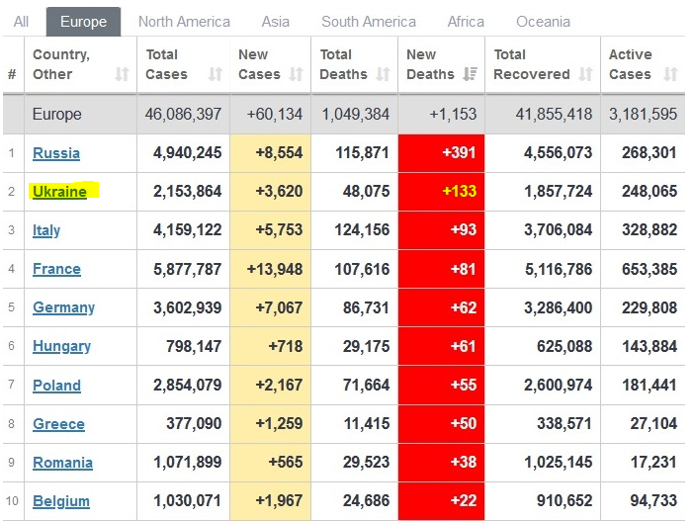
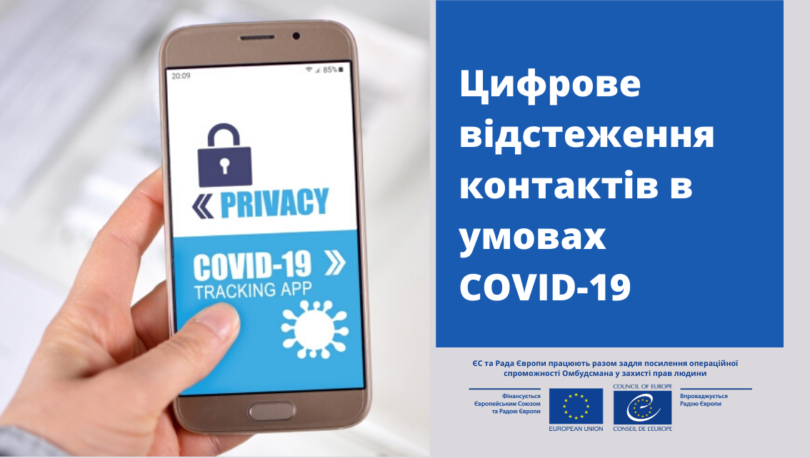
Emergance of application „Diy VDOMA“
Privacy or health?
Ukraine's’ unsavoury statistics with COVID - 19

Slide 3
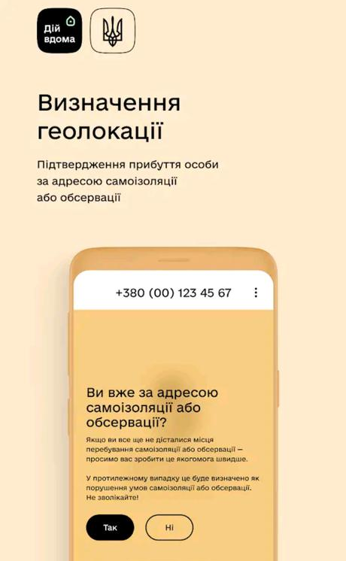
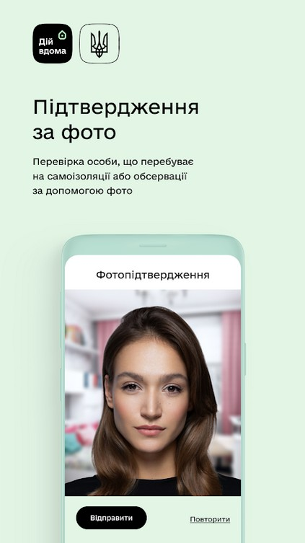
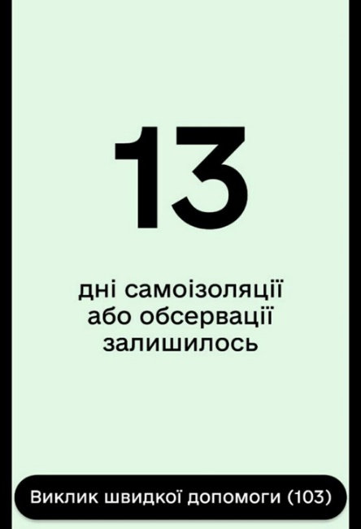
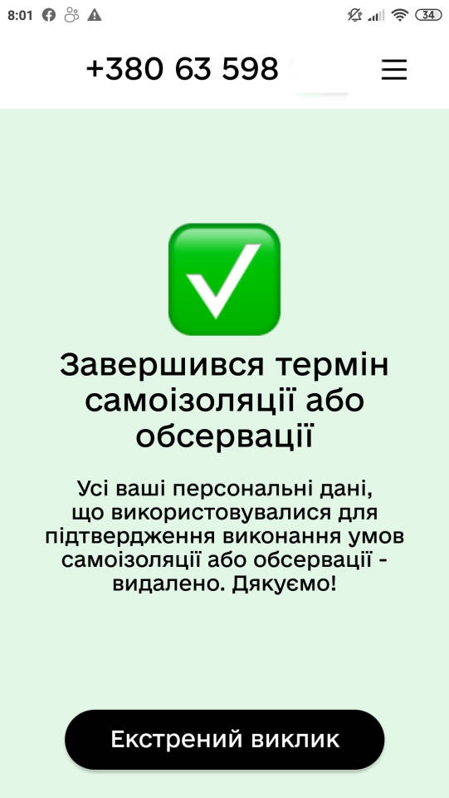
Workflow of the application
24-hour window for arrival
AI facial recognition
Two-week countdown
Finish

Slide 4
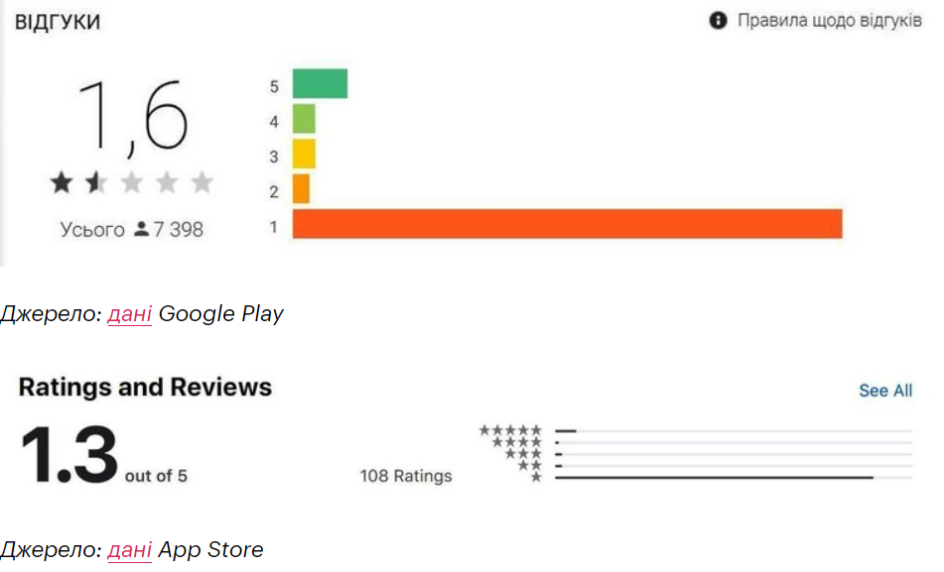
Population reception
According to the Ministry of Digital Transformation of Ukraine, as of the beginning of May 2020, more than 32,000 individuals in Ukraine used the mobile application "Act at Home" to control the self-isolation regime.
User rating for different platforms

Slide 5
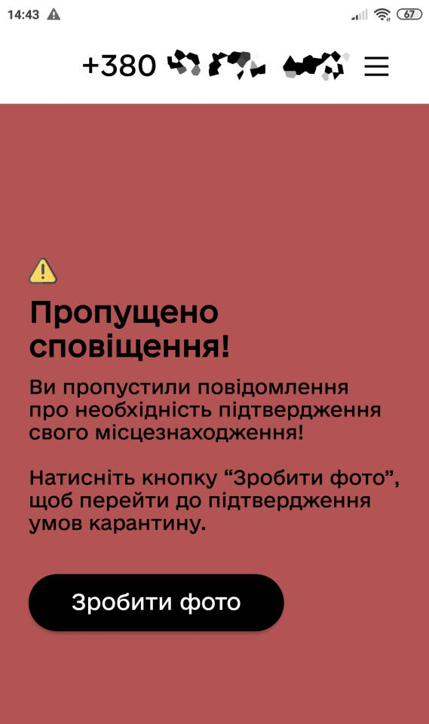
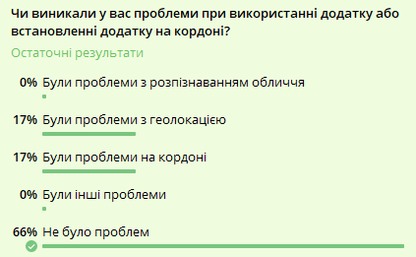
Common ISSUES
"Violation of the rules on quarantine of people" entails the imposition of a fine (17 000-34 000 UAH) (500 – 1000 EUR)
From 67 respondents on Telegram, 17% reported experiencing bugs with geolocation in the app, 17% reported problems at the border with installation and 66% had no problems
When push notifications is ignored…
Telegram poll in a travel-related chat

Slide 6
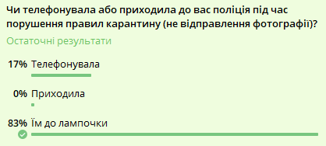
Police reaction to violations
From 67 respondents on Telegram, 83% reported that the police didn‘t much care whether they were complying with the rules of the application and 17% reported calls
Telegram poll about police experience

Slide 7
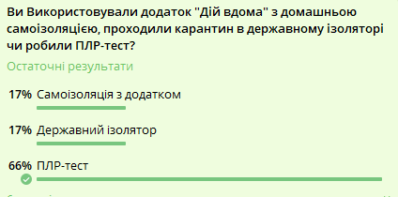
Alternatives
In recent months, most people in the travel chat where the poll was posted opted for a PCR-test that enables people not to use the app
Telegram poll concerning the alternatives after arrival

Slide 8
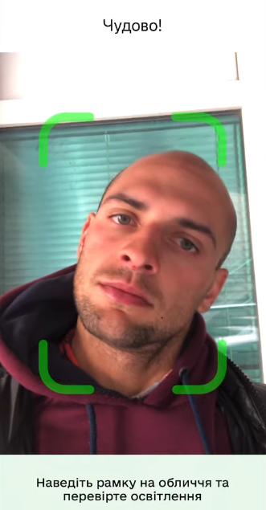
Is THERE A WAY TO DECEIVE IT?
Before sending the data for check with the initial picture, it requires the person to perform certain actions, like blinking or turning ones head. This makes it impossible to deceive the app by feeding a photocard in it, for example.
If app is denied access to geolocation in one‘s phone settings, it instantly complains about it and a warning is received.
Thus, the only way to bypass the application is literally installing it on a different SIM-card, deleting the app and throwing away the SIM. This way the database will have a “wrong” number in the database and all attempts to call the number will be futile. This is of course illegal

Slide 9

Is THERE Any LAW and Security ISSUES here?
According to Convention № 108 on the Protection of Individuals with regard to Automatic Processing of Personal Data, Under any circumstances, to ensure the legality of the use of the mobile application "Act at home" it is necessary that this service is based on human rights standards for non-interference in personal, family life, protection of personal data in connection with their automated processing, defined in acts of the Council of Europe.

Slide 10
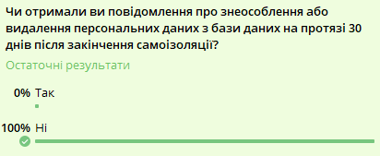
Is THERE Any LAW and Security ISSUES here?
The law stipulates that that for the period of quarantine or restrictive measures related to the spread of coronavirus (COVID-19), and within 30 days from the date of its abolition, the collection and processing of personal data without the consent of individuals is allowed.
Within 30 days after the end of the quarantine period, such data shall be depersonalized and, if impossible, destroyed and the person notified.
Unfortunately, not a single respondent in the group received the message about such measures..

Slide 11
Conclusion
The conducted research hints at possible security issues with the application. What happens to personal data after the end of self-isolation remains open as neither one of us nor any of the respondents received messages about the deletion of the personal data. Thanks to this research and information, we ourselves have contacted the ministry of Health and asked them to shed some light on the issue, with no response insofar.
On a final note, some layers allege that the control of freedom of movement is only legal if there is a martial law or imposed emergency situation in Ukraine, which there isn’t. That said, if the police attempts to fine somebody, such decision can be easily disputed in the court with possible moral compensation.

Slide 12
Much obliged for your attention!

